Slide 1
Benchmarking advisor fees and services
Ann Schleck and Co. is not affiliated with MFS. The information presented herein was provided by Ann Schleck and Co., and MFS cannot guarantee its accuracy and/or completeness.
NOT FDIC INSURED • MAY LOSE VALUE • NO BANK GUARANTEE
2009 MFS Fund Distributors, Inc.
17362.1 6/09
Notes:
1
Understanding how your fees & services compare is a critical factor in winning & retaining plan sponsor relationships
Advisor’s value is marginalized when fees are communicated & compared on a simple spreadsheet basis. It’s important to communicate both fees & the value of your services to clients.
Our goal at MFS is to be your resource for fee & service benchmarking. We have the research & the tools to help you benchmark & communicate your value to your clients.

Slide 2
Advisor Fees and Services
CONTENTS
Retirement Advisor Fee and Service Trends
Database methodology
Fee methods and averages
Retainer versus project-based fees
Investment and fiduciary services
Communicating Advisor Fees and Services to Plan Sponsors
Best practices for communicating fees
Annual advisor fee and service review template
Fee Benchmarking Tools
Notes:
For today’s session we will cover 3 topics;
Fee & Service trends for Retirement Specialist Advisors
Tools available at MFS to help you benchmark your fees for a specific plan
Strategies for communicating fees to clients including a template for an annual advisor fee & service review

Slide 3
ADVISOR FEE & SERVICE TRENDS

Slide 4
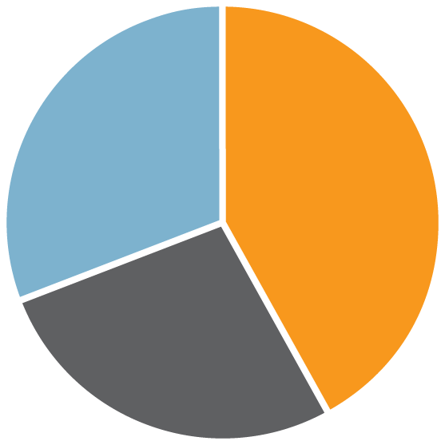
Advisor Fee Trends
FEE BENCHMARKERTM
Database Composition
120 practices, 727 retirement specialists, 5000+ defined contribution (DC) plans
Business models represented
DC assets under advisement
0 to $100M | 27%
$101M to $500M | 36%
$501M to $1B | 15%
Over $1B | 22%
31%
Affiliated FAs
42%
RIAs
27%
Fee Only Consultants
Notes:
The data contained in the Fee Benchmarker™ database was developed by Ann Schleck & Co., an independent consulting firm. The database includes fee schedules from over 120 retirement practices representing 727 full-time retirement plan specialists and retirement assets under advisement of more than $100 billion.
Advisors Represented in the Database include;
Affiliated Financial Advisors These practices are affiliated with a bank or wirehouse & comprise 31% of the database.
Independent Registered Investment Advisors (RIA). These firms are paid via commission or on a fee-for-service basis, depending upon the client. They comprise 42% or the database.
Fee-Only Consultants These practices are compensated on a fee-for-service basis with no commission payments. They comprise 27% of the database.
The database is representative of firms with a wide range of Defined Contribution (DC) assets under advisement. Of the participating firms, 36% have DC assets under advisement of between $100 & $500 million, and 22% have more than $1 Billion in DC assets under advisement.
The average DC assets under advisement for the entire database population is $817 million.

Slide 5
Staffing Norms
TYPICAL RETIREMENT PRACTICE STAFFING LEVELS
Full-Time Retirement Staff
1 to 3 employees | 45%
4 to 7 employees | 37.5%
8 to 12 employees | 12.5%
Over 12 employees | 5%
Retirement Staff by Business Model
 | FT Staff Range | Mean
Affiliated FAs | 1 to 11 | 3.9
Independent RIAs | 1 to 53 | 5.8
Fee-only consultants | 1 to 65 | 7.5
Average of 1 full-time retirement specialist for every $169 million in assets under advisement
Notes:
The total number of full-time retirement specialists represented in the database is 727. Forty-five percent of the participating firms have between 1 and 3 fulltime Retirement Specialists on staff, while another 37.5% have between 4 and 7 fulltime Retirement Specialists on staff.
The average number of full-time retirement specialists varies from 3.9 to 7.5, based on the business model; however, because some of the independent RIA and Fee-Only Consultant firms have larger staffs, that average is higher.
The median number for all three business models is 4.

Slide 6
Fee Methods
ADVISOR FEE METHODS BY PLAN SIZE
Trends
Most advisors use a standard fee schedule
Custom pricing for complex plans
Asset-based for current clients
Flat fee for new clients
Who charges the most?
Plans under $5M: Fee-based consultants
Plans $25M to $50M: FAs
Plans over $200M: RIAs
 | Asset-Based Fee | Flat Fee | Flat Fee + Asset-Based
Under $10M | 82% | 13% | 5%
$10M | 75% | 19% | 6%
$25M | 68% | 23% | 9%
$50M | 66% | 23% | 10%
$100M | 46% | 37% | 17%
$500M | 17% | 50% | 33%
Percentages may not add up to 100% due to rounding
Notes:
Most advisors and consultants have a standard fee schedule. Custom pricing is frequently used to adjust for plan complexity, services and the overall client relationship.
Although the trend is toward a flat fee-for-service for new business, the majority of firms in the database still use an asset-based fee schedule for their current book of plans.
With the industry focus on fees and disclosure, the need to ensure that plan sponsors understand how much and what they are paying for is paramount. Equally important is the advisor’s ability to convey the value of the services they deliver.

Slide 7
Use of Fee Caps
PERCENT OF ADVISORS THAT CAP FEES
Factors Driving Advisor’s Fees
Plan complexity
Sophistication of the sponsor
Plan committee structure
Plan size
Multiple sites/locations
Frequency of investment reviews
Number of meeting days
Seniority of advisor team
Fee Caps By Plan Size
 | Percent That Cap | Low | High
Overall Database | 31% | $3M | $250M
FAs | 26% | $100M | $250M
RIAs | 55% | $3M | $100M
Fee-Based Consultants | 19% | $20M | $250M
Notes:
Advisor Fee Caps
Fee caps are defined as a fixed fee amount even as the plan asset size grows. Of the firms in the database, 31% utilize a fee cap. Of the 31% that cap fees, 55% are independent RIAs. Fee caps are most common in plans with assets of $100 million or more, yet some advisors cap their fees at plan sizes as low as $20 million and others are in the process of implementing fee caps.
Several factors drive how an advisor’s fee is determined: These include…[refer to left side column on the slide]

Slide 8
Scope of Services
SERVICES COMMONLY INCLUDED IN THE ANNUAL RETAINER
Investment policy development
Investment fiduciary to the plan
Fund menu design
Investment monitoring and committee meetings
Fund replacements and fund manager searches
Plan design consulting
Provider fee and service reviews
Provider management and oversight
Education program strategy
SERVICES NOT COMMONLY INCLUDED IN THE ANNUAL RETAINER
Acting as fiduciary to participants
Asset allocation modeling
Compliance reviews
Notes:
Eighty percent or more of the firms in the database provide the following services as part of their annual recurring (or Retainer) fee: [refer to list on slide]
Depending on the plan size, 30% or more of firms do not offer the following services:
Acting as fiduciary to participants
Asset allocation modeling
Compliance reviews
Vendor searches and employee meetings are the services most commonly provided on a project or à la carte basis.

Slide 9
Ongoing Investment Reviews
FREQUENCY OF INVESTMENT REVIEWS BY PLAN SIZE
Plan Size | Annually | Semiannually | Quarterly
$5M | 18% | 26% | 55%
$25M | 10% | 10% | 80%
$50M | 8% | 8% | 84%
$200M | 0% | 0% | 100%
$500M | 0% | 0% | 100%
Vast majority conduct investment reviews quarterly
Investment Fiduciary
75% are willing to be an investment fiduciary to the plan
Of this 75%, 60% include plan-level fiduciary support as part of retainer
When fiduciary support is charged for separately, common fees are:
5 bps
$3,500 per year to $15,000 per year
Notes:
Quarterly investment reviews are the most common frequency. As the size of the plan increases, so does the frequency of the investment review.
Plan-Level Fiduciary Support Services
Overall, 75% of participating firms agree to act as an investment fiduciary to the plan. Of these firms, 60% include the service in their annual retainer fee.
As the size of the plan increases, a larger percentage of participating firms agree to act as investment fiduciary to the plan.
Some firms do not include plan-level fiduciary services as part of the retainer, but offer and charge for these services separately.

Slide 10
Fee Averages
ANNUAL RETAINER AND CONSULTING FEE RANGES
Annual Advisor Retainer Fee Averages*
Plan Size | Mean/Average Annual Fee | Most Common
$5M | $17,590 | $12,500
$25M | $51,512 | $50,000 and $62,500
$50M | $79,087 | $50,000 and $125,000
* For more information on fees for specific plan sizes, refer to Ann Schleck & Co. Fee AlmanacTM or online Fee BenchmarkerTM
Consulting Fee Examples
Service | Fee Range
Vendor search | $3,000 to $40,000
Provider fee & service reviews | $3,000 to $10,000
Investment policy | $2,000 to $10,000
Employee meetings | $500 to $3,000 per day
Notes:
Here is a summary of annual retainer fee averages by plan size
An annual retainer is the fee (asset-based or flat) that an advisor receives on a recurring annual basis for the services provided to a plan.

Slide 11
Communicating fees
to plan sponsors
Notes:
11

Slide 12
Communicating Fees to Plan Sponsors
RECOMMENDATIONS
Develop a fee philosophy and overall communication approach
Benchmark your fees and services to industry norms and share the results with plan sponsors
Proactively disclose your fees on a quarterly invoice, even if no explicit fees are charged
Conduct a year-end fee and service disclosure summary
Document your client’s ROI as part of your annual fee disclosure
Broaden your fee discussion to include plan-level cost savings ideas
Notes:
Research tells us that a majority of retirement plan advisors proactively communicate their fees to plan sponsors. This may be done in the Advisor service contract, or informally at the year-end pension committee meeting. What is less clear, is whether an Advisor is effective at communicating not only hi/her fees, but the return on investment clients receive working with the advisor.
Our recommendations for communicating your fees & services to sponsors are as follows:
Conduct an annual advisor fee and service review with clients.
Provide a recap and summary of the plan results you have achieved for the client in an annual Advisor ROI report.
In your annual review, provide proactive recommendations regarding overall retirement benefit cost savings; for example:
Alternative match formulas
Fund menu designs utilizing lower cost investments
Reduction of print-passed education materials (statements, enrollment kits)
Direct pass-through of transaction fees to participants (loans, distributions)
New ways to reach decentralized workforce locations via technology
Automation of manual processes
Benchmark your Advisor fees to an independent source to ensure they are competitive and you are being paid appropriately for the plan, based on the size and services you are delivering.
Ask your MFS representative to run a Fee Benchmarker™ report for you.

Slide 13
Annual Fee Disclosure
POTENTIAL TOPICS TO INCLUDE IN YOUR ANNUAL FEE DISCLOSURE
Your fee philosophy and approach
For example…
“We disclose our fees on a proactive and transparent basis”
“Our goal is to be competitive, but we are not the low-cost provider”
Annual goals and results achieved for the plan
Fee education
Types of fees in qualified plans
Key terms and definitions
Factors driving fees
Cost savings ideas
Sponsor’s fiduciary role with fee management
Itemization of your fees
How fees are charged and paid
Notes:
MFS’s advisor fee and services communication template (attached) can be used as a tool to communicate your fees, services and value you deliver to the plan sponsor during the year.
Let’s review the features of the template [review content of the template using the list noted on the PowerPoint]
Your MFS contact can help you develop & utilize the fee & services template.
You should review the template with your BD & other appropriate internal sources prior to its use.

Slide 14
Fee benchmarking tools
Notes:
MFS can provide you with a fee / service comparison using Fee Benchmarker™.
Here is how it works [move to the next page & distribute a sample report]

Slide 15
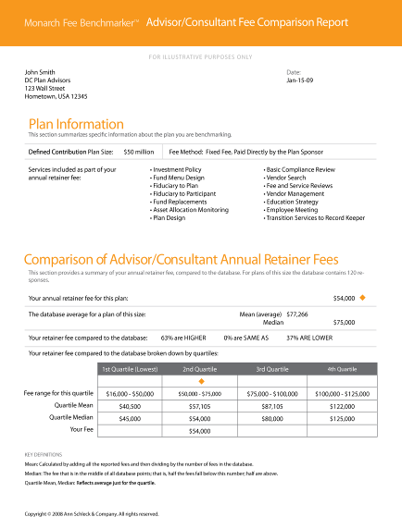
Fee Benchmarking Tools
FEE BENCHMARKERTM
LETS ADVISORS COMPARE FEES & SERVICES FOR A SPECIFIC PLAN TO INDUSTRY NORMS
Fee BenchmarkerTM Report…
Compares fees with similar practices
Quartile rankings
Scope of service comparisons
Commission and fee-for-service illustrations
To request a report, contact your MFS sales representative
Notes:
Fee Benchmarker™ provides customized fee reports. In a few simple steps, you can produce a sponsor-ready report that compares advisor fees and services for a specific Defined Contribution plan to similar practices.
To request a report, contact your MFS Sales Representative.

Slide 16
Thank you
FOR MORE INFORMATION, PLEASE CONTACT
Name
Phone
E-mail
17362.1 6/09
Notes:
Thank you for attending today's session on benchmarking advisor fees & services.
We hope we successfully provided you with;
An understanding of advisor fee & service norms
Ways to communicate your value to clients via the MFS template “Communicating your fees to clients”
Resources available from MFS to help you benchmark fees for a specific plan.
We have several value added programs as part of our Advanced (k) curriculum [hand out the brochure]

